Slide 1

Slaughden SMP Policy Review
Content.
Recap of phase 1 study outputs.
Phase 2 report outputs.
Policy change decision.
Phase 2 reports review.
Phase 3 – Next steps.
SCF 09/07/18
working in partnership along the coast

Slide 2
Slaughden SMP Policy Review. Phase 1 Recap
Location plan
SCF 09/07/18
working in partnership along the coast

Slide 3
Slaughden SMP Policy Review. Phase 1 Recap
Policy Unit 15.1 | Current SMP Policy
To 2025 | Hold The Line
2025 –2055 | No Active Intervention
2055 –2105 | No Active Intervention
No Active Intervention is noted as ‘An interim policy pending an agreed Management and Investment Plan for the Alde and Ore area’
SCF 09/07/18
working in partnership along the coast

Slide 4
Slaughden SMP Policy Review. Phase 1 Recap
Policy Review Study Scope
Phase 1:
High-level review and assessment to provide a baseline appreciation of aspects that are key to identification of a viable policy, with a focus on implementation measures.
Informed by this high-level assessment the CSG can conclude a preferred way forward, i.e. whether to pursue any policy change and what the nature of that change might be.
Phase 2:
Further detailed assessments, including more detailed environmental appraisals, to be undertaken as required to fully appraise the proposed policy change, including formal engagement with statutory consultees required as part of that process.
Phase 3:
Upon completion of necessary studies the proposals will be subject to wider consultation, to review and agree the policy changes. Following this, and taking responses into account, the policy change process can be finalised accordingly.
SCF 09/07/18
working in partnership along the coast

Slide 5
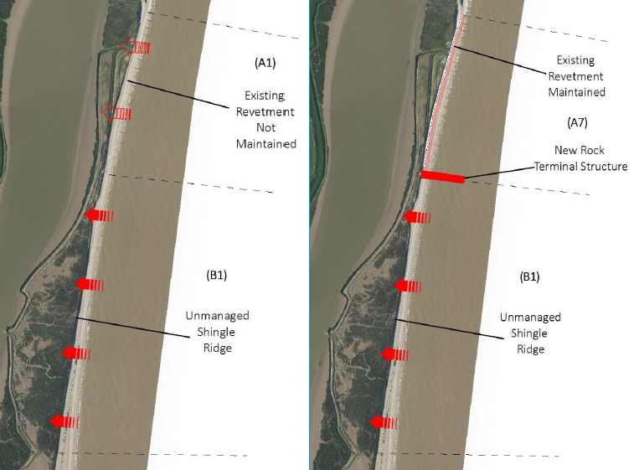
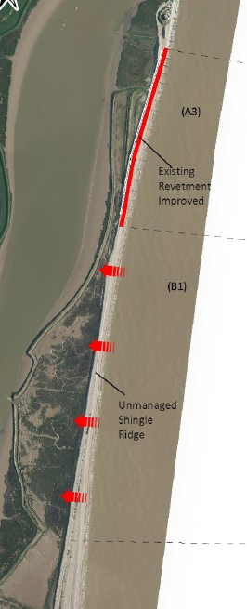
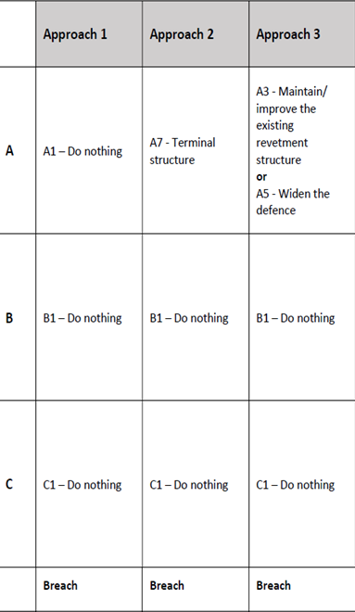
Slaughden SMP Policy Review. Phase 1 Recap
‘Breach’ Approaches 1 – 3 inclusive.
•Certain options would lead to a permanent opening along the shingle barrier, with significant changes in the wider estuary system and adjacent shorelines
•No direct costs for this policy unit, but costs of up to £4m will be incurred to secure the Slaughden frontage to the north.
SCF 09/07/18
working in partnership along the coast

Slide 6
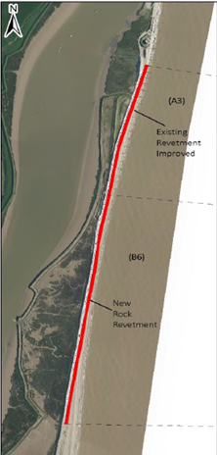
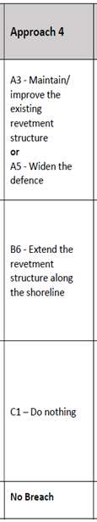
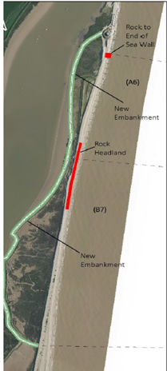
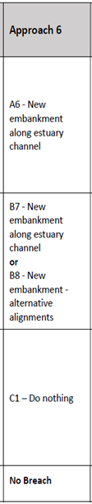
Slaughden SMP Policy Review. Phase 1 Recap
‘No Breach’ Approaches 4 & 6
•Various approaches and combinations possible to continue to provide a continuous barrier between the estuary and the sea
•Typically, initial costs range between £10 and £20 Million
•Ongoing costs (to 2055) are typically a further £0.5 to £2 Million
SCF 09/07/18
working in partnership along the coast

Slide 7
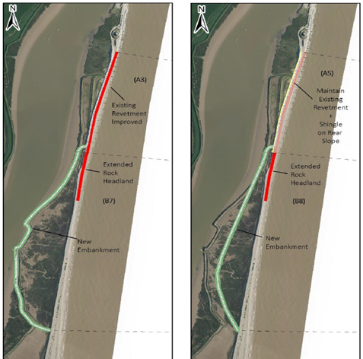
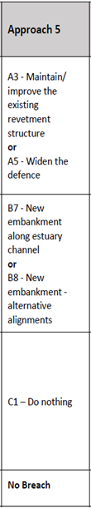
Slaughden SMP Policy Review. Phase 1 Recap
‘No Breach’ Approach 5
•Various approaches and combinations possible to continue to provide a continuous barrier between the estuary and the sea
•Typically, initial costs range between £10 and £20 Million
•Ongoing costs (to 2055) are typically a further £0.5 to £2 Million
SCF 09/07/18
working in partnership along the coast
Notes:
‘

Slide 8
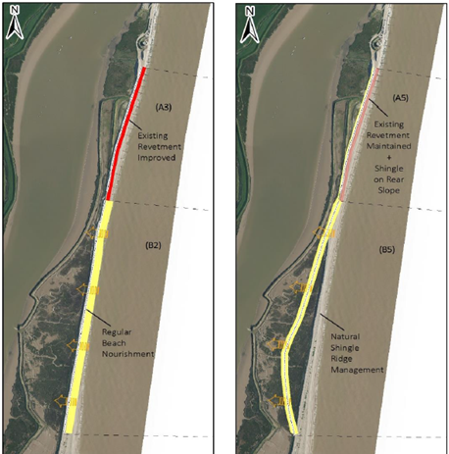
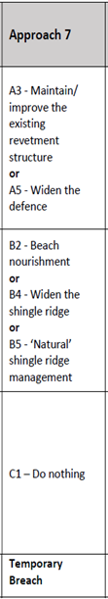
Slaughden SMP Policy Review. Phase 1 Recap
‘Temporary Breach’ (repaired) Approach 7
•Although a barrier will remain in some form, it may be occasionally breached (in sub-unit B) meaning a temporary interaction between the sea and estuary
•Typically, initial costs would be between £5 and £8 Million
•Ongoing costs (to 2055) are typically a further £2 to £3 Million
•There will be some correlation between level of cost and level of breach risk
SCF 09/07/18
working in partnership along the coast

Slide 9
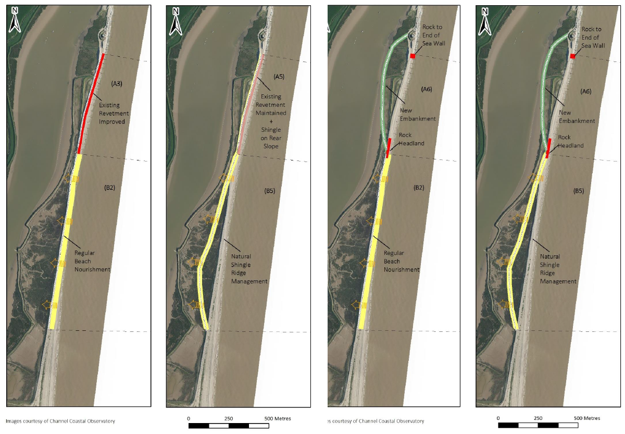
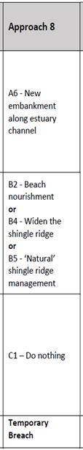
Slaughden SMP Policy Review. Phase 1 Recap
‘Temporary Breach’ (repaired) Approach 8
•Although a barrier will remain in some form, it may be occasionally breached (in sub-unit B) meaning a temporary interaction between the sea and estuary
•Typically, initial costs would be between £5 and £8 Million
•Ongoing costs (to 2055) are typically a further £2 to £3 Million
•There will be some correlation between level of cost and level of breach risk
SCF 09/07/18
working in partnership along the coast

Slide 10
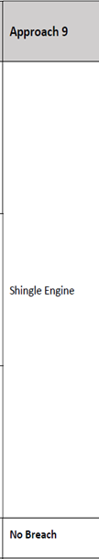
Slaughden SMP Policy Review. Phase 1 Recap
‘No Breach’ Approach 9 – Shingle Engine
•Major dredge and nourishment operation followed by a re-distribution of shingle, or a repeat of initial operation.
•Initial costs around £20 Million.
SCF 09/07/18
working in partnership along the coast

Slide 11
Slaughden SMP Policy Review. Phase 1 Recap.
The CSG recommendation to SCF January 2018 was:
Subject to further studies, to change Policy for Unit 15.1, Slaughden, in epoch 2 from No Active Intervention to Managed Realignment.
The intent for management is to `Provide resilience against erosion whilst working with a dynamic coast’.
The policy to be reviewed ~ 2050 in tandem with the A&OE Plan.
SCF 09/07/18
working in partnership along the coast

Slide 12
Slaughden SMP Policy Review. Phase 2.
Habitat Regulation Assessment
The ‘Preliminary Assessment of SMP Approaches 4 to 8 inclusive against The Habitat Regulations’ helps to identify whether a change to SMP policy may be constrained on environmental grounds.
The assessment for approaches 1 to 3 with an outcome of permanent breach do not present a change from the current SMP policy for epochs 2 and 3 and therefore do not require a detailed assessment. Assessments in the Phase 1 report show that development of a permanent breach will have significant implications for the wider estuary.
This study does not provide a detailed assessment of the wider potential impacts of Approach 9 (Shingle Engine). However, it does identify potential risks and impacts which that approach would likely need to consider if it is progressed.
SCF 09/07/18
working in partnership along the coast

Slide 13
Slaughden SMP Policy Review. Phase 2.
Preliminary HRA Conclusions.
In table 9 of the HRA report approaches 4-8 have been assessed by a RAG process defined below.
Green - unlikely an adverse effect would be identified through a full Appropriate Assessment. There are no Green scores which emphasises the challenging nature of the site.
Yellow - potential adverse effects likely to be identified through an Appropriate Assessment but may be avoided by mitigation.
Red - potential adverse effect or uncertain effects would be identified through a full Appropriate Assessment. Uncertain whether it could be mitigated without detailed assessment.
All approaches have potential to cause damage to the Natura 2000 sites within the study area and its surroundings, as such all will require HRA and Appropriate Assessment to assess adverse effect on site integrity.
SCF 09/07/18
working in partnership along the coast

Slide 14
Slaughden SMP Policy Review. Phase 2.
The overall environmental risk under HRA is summarised as follows:
Approach 4 represents a high environmental risk. It may not be possible to compensate for the loss of designated habitat, to overcome an adverse effect on integrity.
Approaches 5, 6, and 8 represent a moderate to high level of environmental risk. They are likely to result in the loss of designated habitat which may be mitigatable, and the realignment approach works with coastal processes over the longer term.
Approach 7 has potential to work with natural processes and so has low to moderate environmental risk, such that it may be possible to conclude ‘no adverse effect’ with mitigation.
SCF 09/07/18
working in partnership along the coast

Slide 15
Slaughden SMP Policy Review. Phase 2.
The Water Framework Directive (WFD) assessment report presents the appraisal of the proposed approaches at a strategic level, in compliance with the Directive requirements.
The aims of the report are to:
Review information in the SMP2 Water Framework Directive Assessment.
Check each approach option and alternatives against Environmental Objectives.
Identify the potential for any policy change to contribute to deterioration of a waterbody. Where this is the case provide a Summary Statement including any identified mitigation measures.
SCF 09/07/18
working in partnership along the coast

Slide 16
Slaughden SMP Policy Review. Phase 2.
Preliminary WFD conclusions.
Approaches 4 and 7 comply with the WFD objectives.
Approaches 5, 6 and 8 do not meet the criteria, as they enclose the saltmarsh which may result in deterioration of good ecological potential (GEP). With appropriate mitigation i.e. measures to ensure the tidal exchange of saline water into the site, the approaches are considered to be potentially acceptable.
All approaches put forward are predicted to not cause deterioration in water body status or prevent the water body from meeting its objectives.
A scheme-level WFD assessment is required at the design stage of any approach adopted.
SCF 09/07/18
working in partnership along the coast
Notes:
.

Slide 17
Slaughden SMP Policy Review. Phase 2.
Phase 2 report outputs - combined summary.
Both HRA and WFD assessments conclude that approaches 4-8 inclusive are not ruled out but all have residual risk, are subject to scheme detail level assessment and some require mitigation actions.
Based upon the report outputs, the CSG policy change recommendation remains valid.
A shingle engine option is not ruled out.
SCF 09/07/18
working in partnership along the coast

Slide 18
Slaughden SMP Policy Review. Phase 2.
The CSG is recommending a policy change.
The Phase 2 reports illustrate that there are potentially viable ways of delivering the proposed policy.
The SCF is requested to approve the policy change subject to the formal process, which involves public consultation.
SCF 09/07/18
working in partnership along the coast

Slide 19
Slaughden SMP Policy Review. Phase 2.
The Phase 2 reports received on 2/7 are draft and subject to further review and comment by CSG and SCF members.
Feedback should be sent to PP by 16/7/2108.
If there are significant changes to phase 2 report findings the CSG will consult with the SCF by email.
SCF 09/07/18
working in partnership along the coast

Slide 20
Slaughden SMP Policy Review. Phase 3.
Phase 3 will comprise:
A Strategic Environmental Assessment (SEA) Screening study followed by
Community consultation.
SCDC will procure consultant support by tender.
SCDC will apply for FDGiA.
The SCF will be updated on progress at the November 2018 meeting.
SCF 09/07/18
working in partnership along the coast

