Slide 1
Neighbourhood Planning:
Strengthening the role of communities in renewable energy.
Graham McGrath
Centre for Sustainable Energy
Twitter - @cse_bristol

Slide 2
Why include energy policies within a Neighbourhood Plan?
Neighbourhood Plans (by parish councils and self-defining local neighbourhoods)
Local Plans (by Local Planning Authorities)

Slide 3
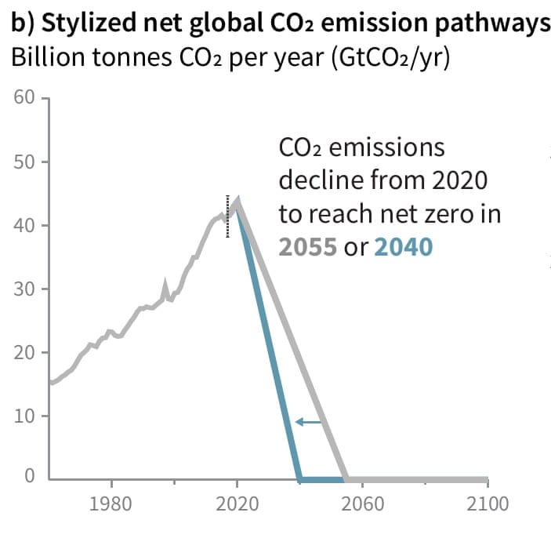
Intergovernmental Panel on Climate Change report 2018
In 2018 the IPCC special report concluded that there are only 12 years to keep global warming below 1.5°C.
Beyond this the risks of drought, floods, extreme heat and poverty for hundreds of millions of people will significantly worsen

Slide 4
16 of the 17 warmest years have occurred since 2000
Hottest year on record - 2016
previous hottest year on record - 2015
previous hottest year on record - 2014
previous hottest year on record - 2010

Slide 5
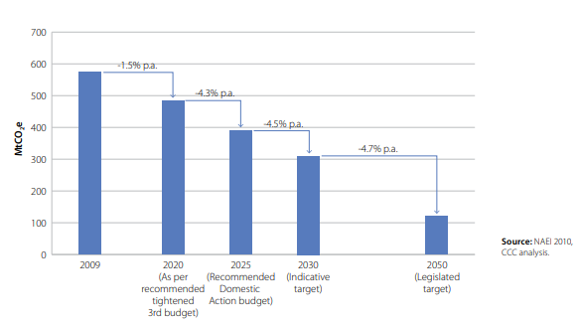
UK response
Climate Change Act 2008 - established a legally binding target to reduce the UK’s greenhouse gas emissions by at least 80% below 1990 base year levels by 2050

Slide 6
UK response
The Climate Change Act introduced a system of successive five-year period carbon budgets to provide legally binding limits on emissions

Slide 7
UK response – the planning system
Local planning authorities are required by the 2008 Planning Act, to ensure that, taken as whole, plan policy contributes to the mitigation of, and adaptation to, climate change.
The National Planning Policy Framework reinforces that:
policies and decisions are in line with the objectives and provisions of the Climate Change Act 2008, and;
discusses the role of planning in securing “radical reductions in greenhouse gas emissions” and maximising renewable energy deployment

Slide 8
Is our response sufficient?
“The UK is not on course to meet the legally binding fourth and fifth carbon budgets.”
Committee on climate change - 2018 Progress Report to Parliament
www.theccc.org.uk/wp-content/uploads/2018/06/CCC-2018-Progress-Report-to-Parliament.pdf

Slide 9
Despite not being on course to meet our legally binding targets….
Since 2015:
Renewable energy subsidies have been scrapped.
The Zero Carbon Homes Policy has been suspended.
Planning permission for onshore wind power has become more restrictive:
E.g. permission will now only be granted if a proposed turbine is located within an area identified in a local or neighbourhood plan and if “it can be demonstrated that the planning impacts identified by affected local communities have been fully addressed”.

Slide 10
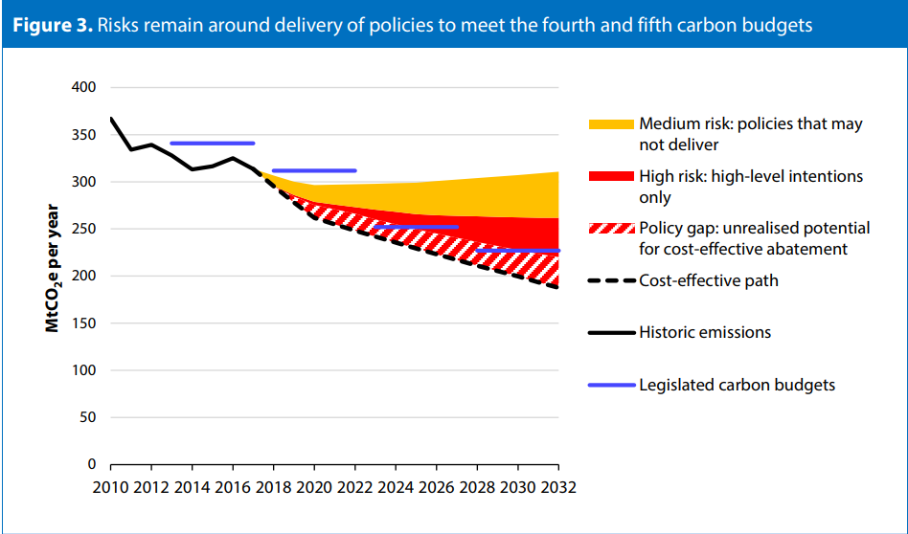
Can Neighbourhood Plans fill this policy gap?
Committee on climate change - 2018 Progress Report to Parliament www.theccc.org.uk/wp-content/uploads/2018/06/CCC-2018-Progress-Report-to-Parliament.pdf

Slide 11
Neighbourhood Plans can:
Create locally specific, place based policy not covered within the local plan strategic policies.
Add detail to strategic policies in the local plan.
Create community consent for a range of strategies (e.g. town centre remodelling, renewable energy projects)

Slide 12
Neighbourhood Plans……..
Go further than local plan consultation or engagement.
Engender a sense of co-creation, and of community ownership of development.
Provide communities with greater financial and social benefits by engaging them in the planning system at the earliest possible stage:
CIL revenue from developers increases from 15% to 25%
The community can chose where this revenue is spent

Slide 13
Community
Principles
Vision setting
Policies
Actions

Slide 14
A huge opportunity for tackling climate change:
To normalise and localise climate change discussion, which is normally disparate from daily life.
To kick start take effective local action on climate change where national government policy is lacking.
But…..
What options are there – and what are the most effective for your area?

Slide 15
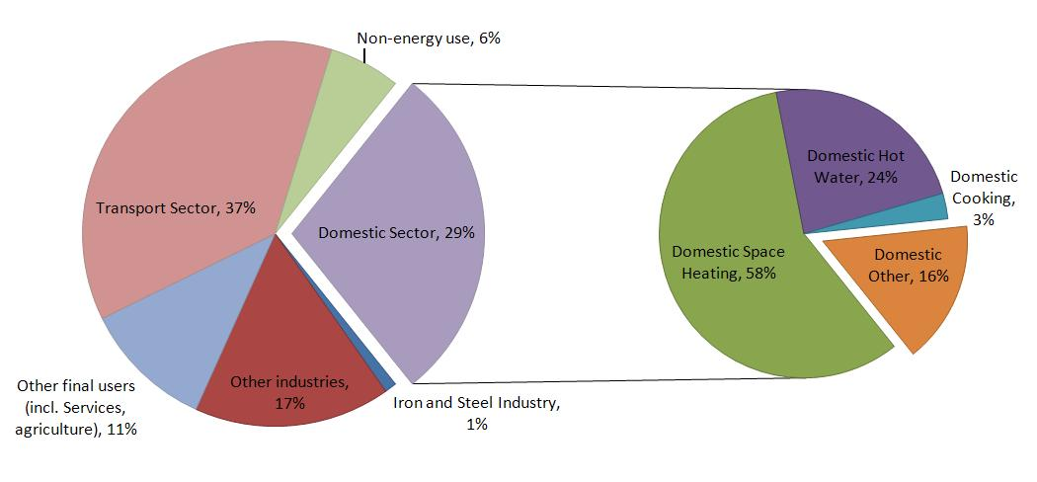
Planning for energy is not only about energy generation. It is also about ensuring high levels of energy efficiency.
What planning policies can be implemented to mitigate these carbon emissions?

Slide 16
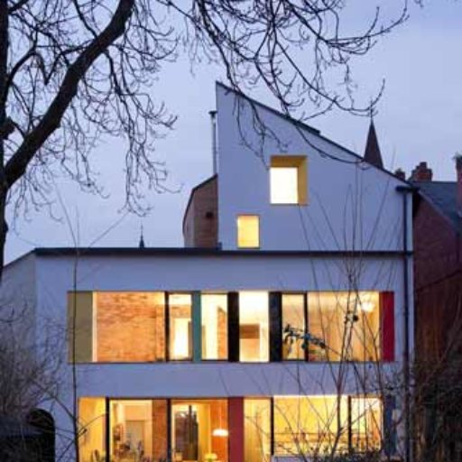
Energy efficiency in domestic buildings
The majority of buildings which will being used in 2050 have already been built. Therefore encouraging sensitive retro- fitting of historic buildings is essential.
Neighbourhood Plans can demonstrate that historic value and energy efficiency improvements can coexist.

Slide 17
Filling gaps in council policies – domestic energy efficiency
Lack of clarity from central government whether Neighbourhood Plan groups can set their own binding energy efficiency standards.
However…..
We are currently supporting a number of neighbourhood plan groups who wish to develop binding energy efficiency targets for new development

Slide 18
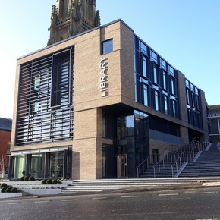
Filling gaps in council policies – commercial Energy efficiency
"All non-residential buildings to aim for BREEAM standards of ‘very good’ or ‘excellent’
Tickhill Neighbourhood Plan - made July 2015
New non-domestic buildings must meet the BREEAM rating of at least ‘Very Good’
Doncaster Core Strategy 2011 – 2028

Slide 19
Energy use policy – the Merton Rule
Named after the council which adopted the first prescriptive planning policy to require new commercial buildings over a certain size to generate at least 10% of their energy needs using on site renewable energy equipment.
“All new developments must secure at least 10% of their total regulated energy from decentralised and renewable or low carbon sources.”
Tickhill Neighbourhood Plan - made July 2015 –

Slide 20
Renewable Energy Generation Policies ?

Slide 21
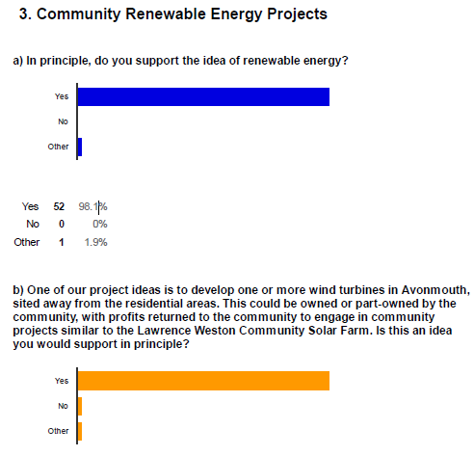
Community owned renewable energy with public consent

Slide 22
Renewable Energy
“Proposals for the generation of renewable energy will be supported provided the adverse impacts are satisfactorily addressed, or are outweighed by the overall benefits of the proposal.”

Slide 23
Renewable Energy – identifying sites

Slide 24
Renewable Energy – identifying sites

Slide 25
Energy generation – Elements of a Renewable Energy policy
Sufficient?: Supports renewable energy in principle
Better: … and specifies types supported and criteria for support
Better: …and identifies potential renewable energy resources
Best: ... and identifies specific sites or areas for renewable energy production

Slide 26
Moving from generalised support for renewables to detailed policies

Slide 27
Neighbourhood Plans and community energy
Shared consultation and engagement process.
Neighbourhood Plans build community momentum
Neighbourhood Plans can secure funding for community energy through CIL Revenue.
Neighbourhood Plans vital for securing successful planning permission for onshore wind.
“permission will now only be granted if a proposed turbine is located within an area identified in a local or neighbourhood plan and if “it can be demonstrated that the planning impacts identified by affected local communities have been fully addressed”.

Slide 28
Lawrence Weston, Bristol
Cut off from neighbouring communities; falls within the most deprived 10% of areas in England for Multiple Deprivation.
Above average rate of fuel poverty (14.5% of residents).
Community Infrastructure Levy funds to be used for:
district heating infrastructure (including a possible heat main to a nearby industrial area).
sustainable energy generation, storage, and dedicated local distribution.
enhancement of existing and creation of new cycle routes.
The community energy group has now secured funding to develop a community wind project.

Slide 29
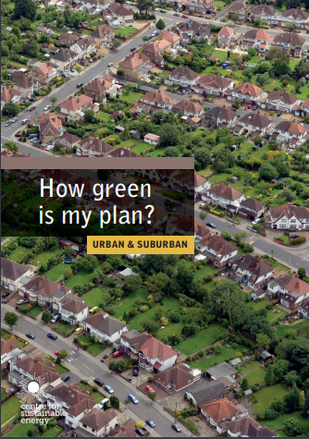
CSE Resources
www.cse.org.uk/neighbourhoodplanning

Slide 30
For free support on your Neighbourhood Plan, please get in contact:
Email: neighbourhoodplanning@cse.org.uk
0117 9341436 (direct) | 0117 9341400 (switchboard)
Centre for Sustainable Energy, 3 St Peter's Court, Bedminster Parade, Bristol, BS3 4AQ

